Slide 1
C# Build Night
Using Windows Forms
to create a polling app
Code With me meetup, 2017-08-24

Slide 2
What is…
WinForms
A Windows-only GUI library. It offers buttons, charts, and other widgets.
Visual Studio offers a “Visual Designer” that gives you a partial WYSIWG interface for WinForms. So starting is easy…

Slide 3
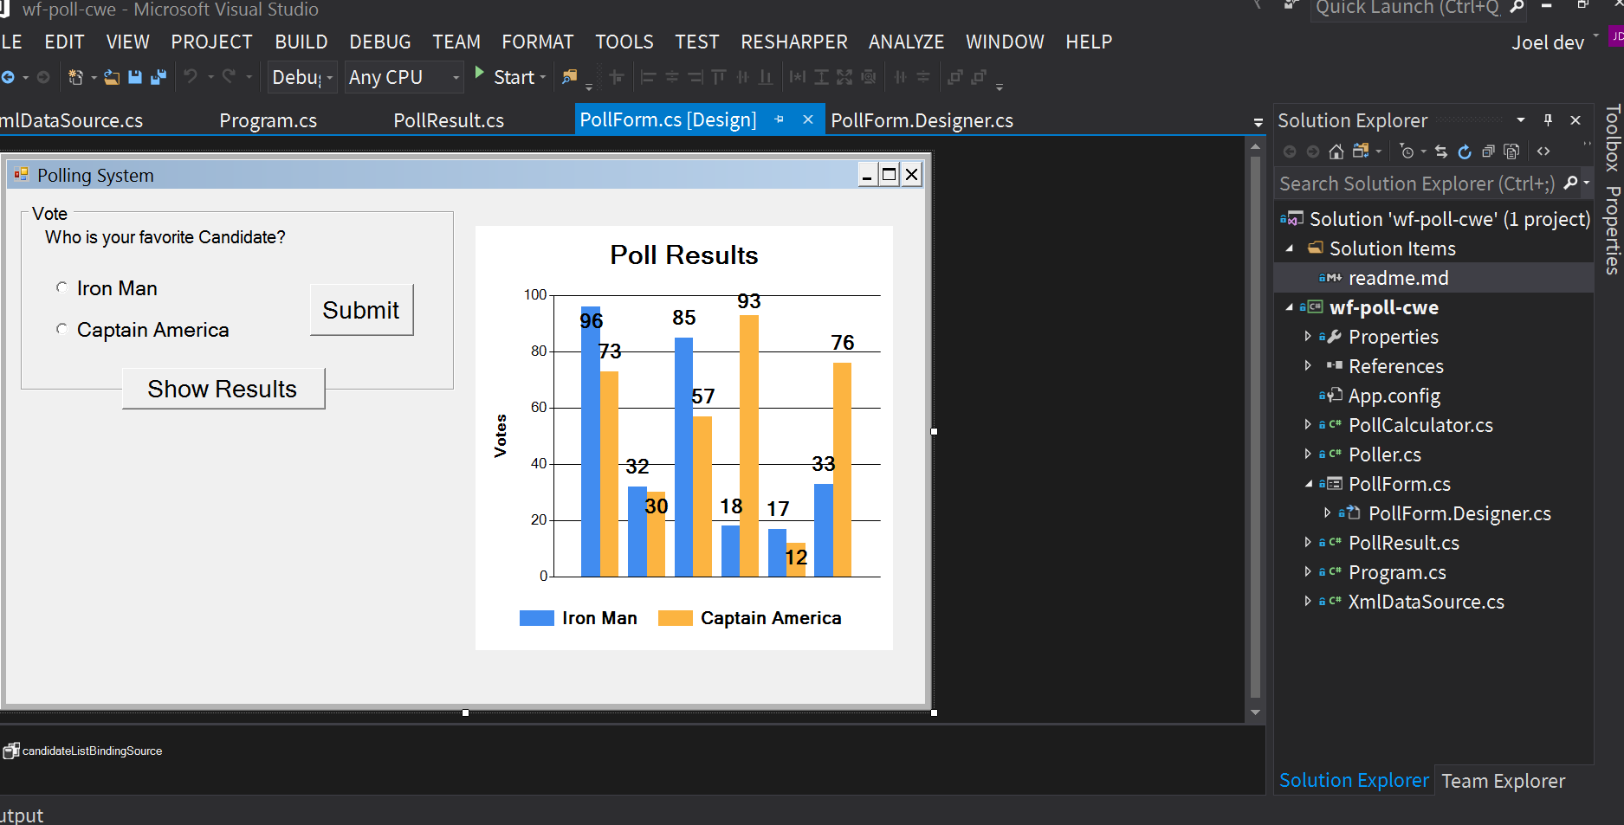
Visual designer in action

Slide 4
List of things we’ll use
WinForms for platform-dependent convenience
Interfaces, for (kind of) modular design
LINQ to extract data from XML
Event-driven programming (e.g. respond to click events)
Some generics, because its hard to avoid

Slide 5
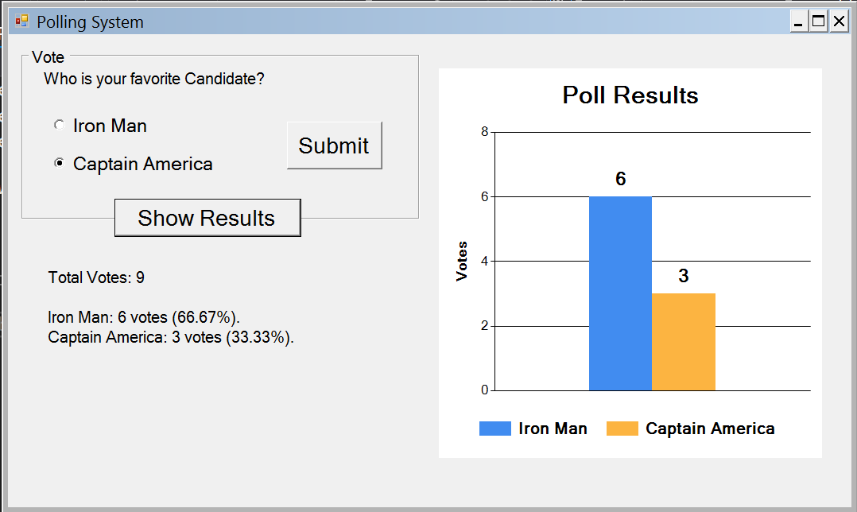
Our project

Slide 6
Our process
We’ll start with the completed project, in a plain text editor.
In Visual Studio, we’ll make a new, fresh project.
Step-by-Step we’ll move code from our completed project to the new one.

Slide 7
Project design
IPoller Poller.cs
PollForm.cs
IDataSource XmlDataSource.cs
PollForm.
Designer.cs
(generated)
IPollCalculator PollCalculator.cs
class CandidateList
struct PollResult.cs

Slide 8
Some things to notice…
Poller connects most of our app together (especially the UI and the model data & logic)
We use some interfaces. When you have different classes, interfaces simplify how one class touches another.
Our UI is mostly generated for us by Visual Studio. We are just hooking up buttons to actions (“events”).

